Slide 1

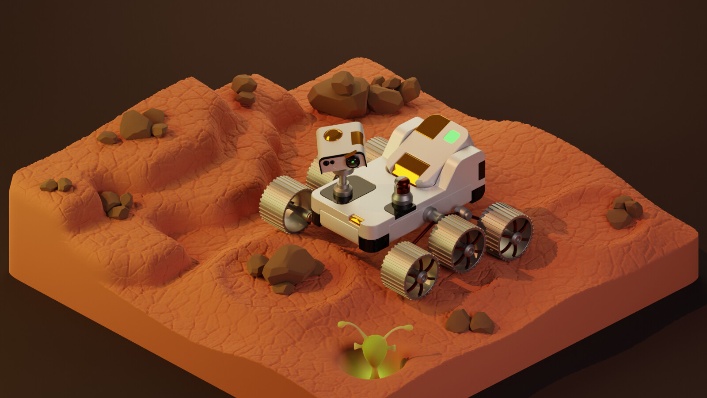
Rover Ready
Chirag Baviskar and Dhrumil Patel

Slide 2

Completed Project Overview
Rover Ready is a browser-based WebXR rover repair bay
The player calls a rover into the bay, powers it, repairs it, checks it, and sends it out
The project stays in one compact garage room instead of trying to become a large level
Built with Blender, Three.js, WebXR, GLTFLoader, and Cannon-ES

Slide 3
Demo Flow
Press CALL ROVER on the bay control panel
Watch the bay door and rover arrival sequence
Grab and insert the power cell into the rover dock
Use the repair tool on highlighted damaged parts
Place missing parts back onto snap targets when a level requires it
Press CHECK, then SEND ROVER once the task is complete

Slide 4
Scene and Custom Assets
Scene Elements
Custom Blender Assets
Low-poly garage bay with floor markings, tool table, diagnostic screen, bay door, and button panel
Stylized six-wheel rover with a visible power-cell dock and repairable components
Rack objects for the power cell and handheld repair tool
Power cell module
Handheld repair tool
Six-wheel service rover
Garage repair bay

Slide 5
Scene and Custom Assets
Scene Elements
Low-poly garage bay with floor markings, tool table, diagnostic screen, bay door, and button panel
Stylized six-wheel rover with a visible power-cell dock and repairable components
Rack objects for the power cell and handheld repair tool
Custom Blender Assets
Power cell module
Handheld repair tool
Six-wheel service rover
Garage repair bay

Slide 6
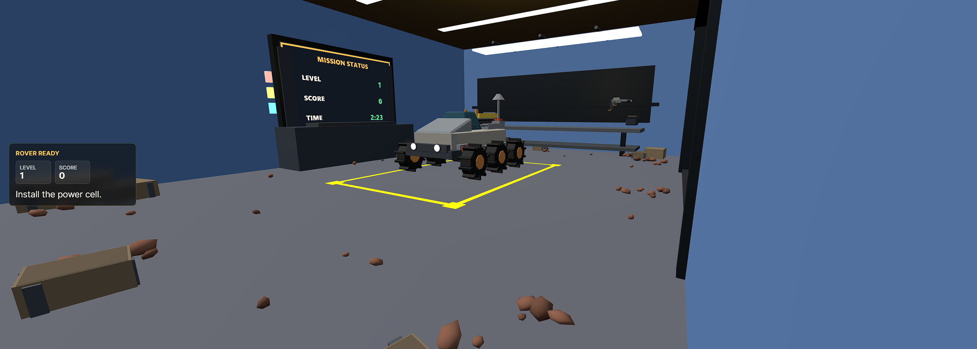
Repair Bay Setup
The rover parked in the work zone, with the mission screen, HUD, tool bench, and bay props visible around it.

Slide 7
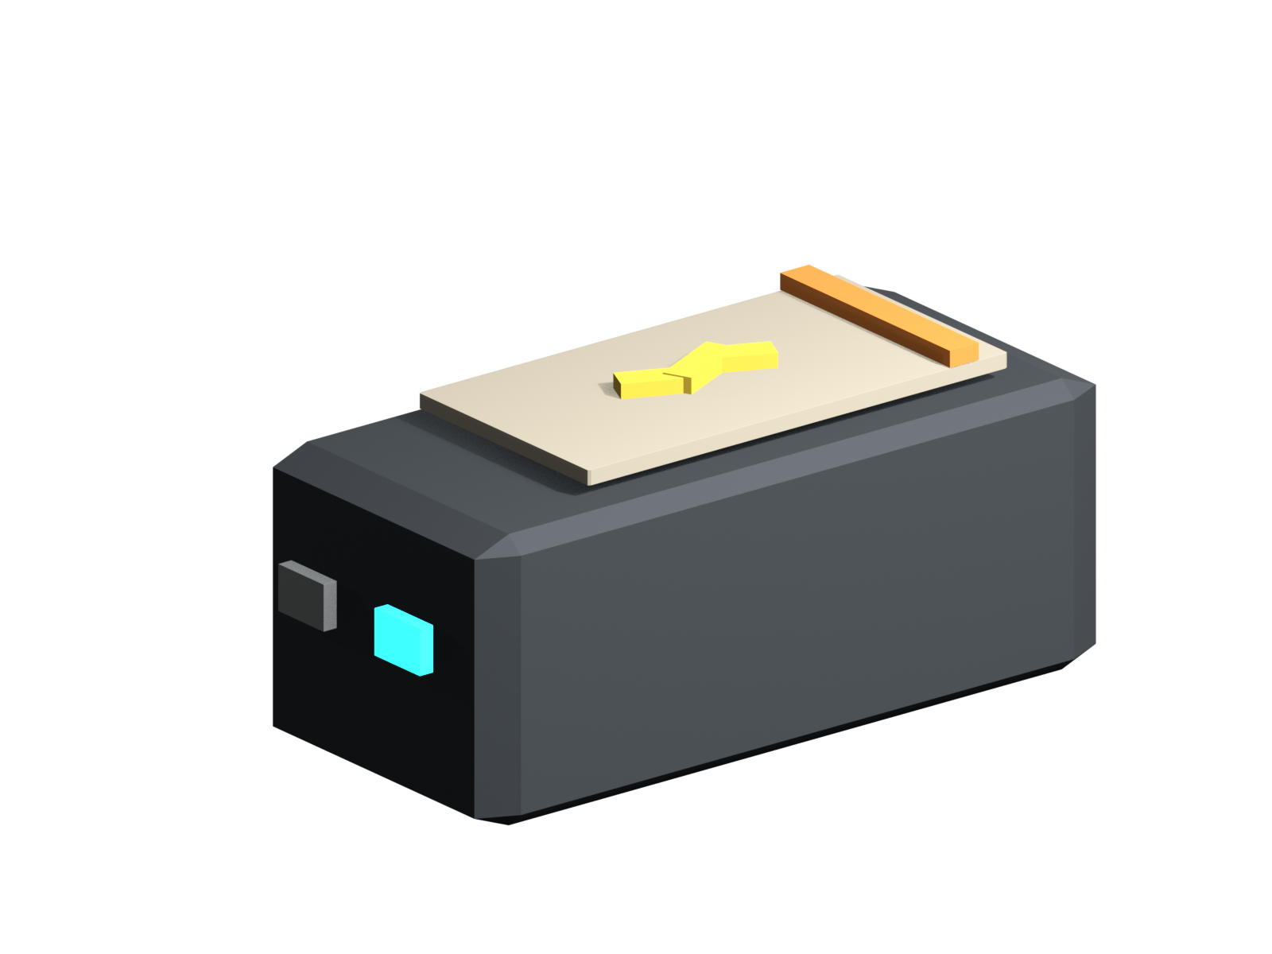
Interaction 1: Power Module Insertion
The power cell starts as a grabbable object on the rack
Cannon-ES gives it a physical body while it is loose
The rover model includes a named snap target for the dock
When the player aligns the cell near the dock, it snaps into place and locks to the rover
The HUD, score, and rover-check state update after insertion

Slide 8

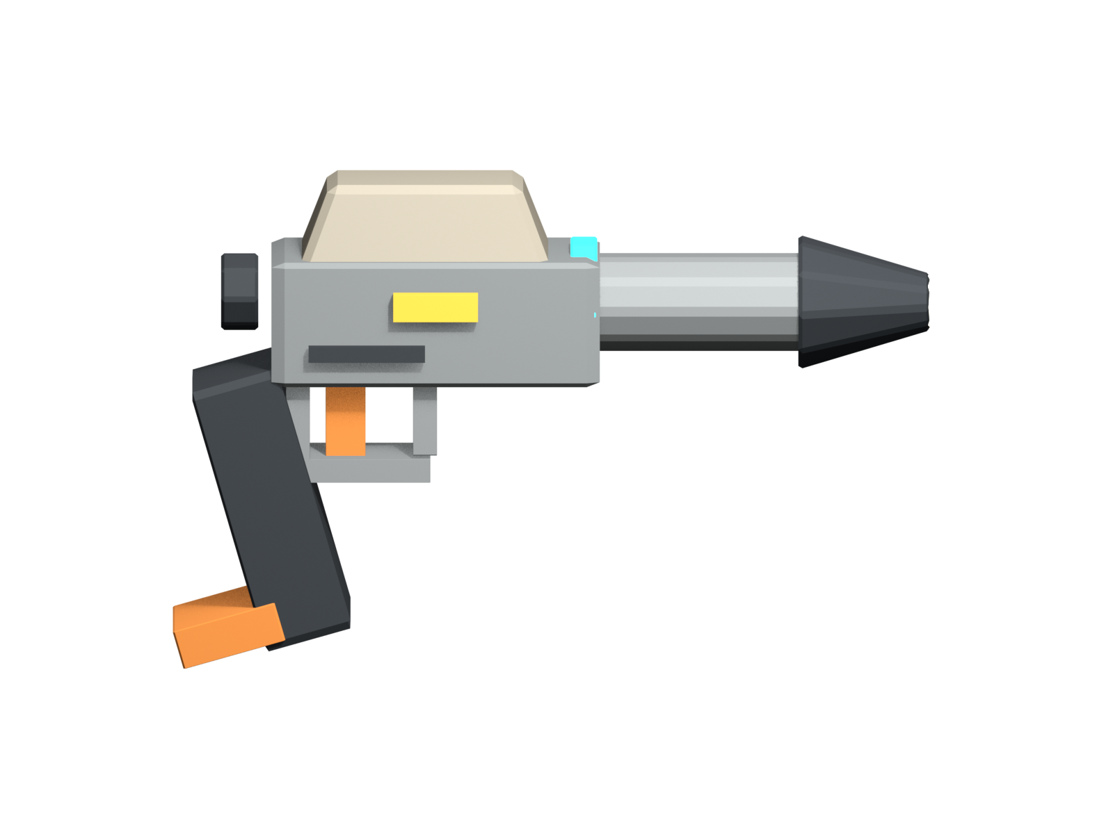
Interaction 2: Repair and Replacement
The repair tool is a separate grabbable object with its own behavior
Damaged targets glow red while the tool is being used
Holding the tool on a target long enough marks it as repaired
Some levels spawn missing rover parts as loose grabbable objects
Missing parts show snap markers and reattach when placed near the correct rover target

Slide 9
Requirement Fit
Base Requirements
Original theme: compact rover repair bay, not a lab reskin
Custom 3D assets: power cell and repair tool, plus custom rover and garage bay
GLTFLoader: runtime loads the garage bay, rover, power cell, and repair tool as separate models
Core interactions: power-cell insertion, repair-tool use, and missing-part reattachment
Advanced Features
Category A: Cannon-ES physics for tools, modules, loose parts, and collision proxies
Category A: multiple object types and modes, including buttons, rover, power cell, repair tool, repair targets, and missing parts
Additional support: Blender Python scripts generate meaningful scene and asset content

Slide 10
Individual Contributions
Chirag
Dhrumil
Blender asset direction for the rover-ready prop set
Low-poly visual consistency, asset cleanup, and export organization
Asset documentation and final packaging structure
WebXR scene setup and Three.js runtime integration
Controller, desktop, and emulator interaction handling
Cannon-ES physics setup and collision proxy behavior
Rover arrival flow, power insertion, repair logic, levels, scoring, and HUD state

Slide 11
Reflection and Future Work
What Was Challenging
What VR Adds
Future Work
Keeping Blender model geometry aligned with runtime snap points
Making physics objects feel stable enough for VR interaction
Avoiding scope creep while still meeting the advanced-feature requirements
Matching visible GLB models with invisible collision and interaction proxies
The power-cell insertion works because the player physically aligns an object in 3D space
The repair tool feels more natural as a hand-held action than as a flat-screen button press
The rover state changes are easier to understand when the player is standing next to it
Add sound effects and stronger tool feedback
Add more varied repair jobs and diagnostic screen states
Polish the rover departure and completion feedback
Improve headset testing beyond the emulator workflow

